Slide 1
















CRM Cheatsheet
WEBSITE & SOCIAL
WEB-TO-LEAD FORM
Organic web traffic
Email responses
Social mentions
Free trial
“Contact me” request
Event registration
INBOUND CALLS
CREATE NEW LEADS
LEAD CAPTURE
MY OPEN LEADS
DUPLICATE LEAD?
Referrals
Google Maps
Search first, then create a new lead in Salesforce
Set up auto-response emails: “Thank you for your interest”
Your trial information
Event details
Set up lead assignment rules
Geography
Company size
Product of interest
Set up different views to manage your leads.
For example, today’s leads or leads sorted by lead type.
Set up duplicate management
to prevent duplicates at the point of entry.
Manually merge legacy records.
LISTS
IMPORT DATA
Purchased list
Trade show
Legacy data
Use the import wizard or data loader
PLAN AND EXECUTE MARKETING CAMPAIGN
Email marketing • Radio
Direct mail
Cold calls
Partners
TV
Events
Trade shows
PR
Sales
Marketing
Opportunity teams
Opportunity splits
Products & Price books
CPQ
Approval
Document generation
Digital signature
Forecasting
ARCHIVE YOUR DEAD LEADS
Use email marketing and call downs to re-market to
unqualified or no-contact leads
Support
WORKING LEADS
QUALIFIED?
OPPORTUNITIES PRESENTATION, PROPOSAL, NEGOTIATION WON
When you’re working a lead, set up a series of tasks based on the type of lead.
For example:
Day 1: Personalize
mass email
Day 2: Call/
voicemail
Day 3: Call/
voicemail
Day 4: Personalize
mass email
Create a set of qualification questions, such as current situation, product of interest, timeframe, key decision makers.
Opportunity is assigned manually on conversion (lead owner). If automatic assignment is needed use custom package workflow rules.
Monitor your opportunities reports and dashboards to keep track of top deals and
prioritize your time.
Customize Salesforce to fit your internal sales processes, making it easier to monitor your sales pipeline
Salesforce gives your entire company a
360-degree view of your customers and facilitates collaboration across your organization, helping you build strong, lasting customer relationships.
If the lead is qualified, convert it to a contact, with an associated opportunity
and account.
ARCHIVE YOUR DEAD OPPORTUNITIES
Use email marketing and call downs to re-market to Closed Lost opportunities

Slide 2




Service Cloud Cheatsheet
WEBSITE, SOCIAL, ONLINE COMMUNITIES
WEB-TO-CASE & MORE
Website visits
Social mentions
Community posts
Support inquiries
Private questions
CALLS
CREATE OR UPDATE CASES
CASE CREATION
SUPPORT PROCESSES
ENTITLEMENTS
Incoming calls
Search in Salesforce and update open cases or create a new case
Set up auto-response emails
Direct to self- service options
Smart routing
Evenly distribute cases
to qualified agents
Set up queues and case assignment rules
Channel
Product
Geography
Define case statuses to support your process. Create multiple processes as needed.
Enhance and enforce your support
processes. Verify
if your customers are eligible for support. Specify Service Level Agreements (SLA) for each customer.
EMAILS, CHATS, & MORE
EMAIL-TO-CASE & MORE
Incoming emails
Incoming chats
Video calls & more
Automatically create cases from emails & incoming chats
Marketing
ESCALATION RULES
REPORTS AND DASHBOARDS
Support
KNOWLEDGE
CTI
COMMUNITIES
CONSOLE
LIVE AGENT FEATURES
Skills
Branding
Save Transcript
Sneak Peek
File Transfer
Assistance flag
Chat transfer & conferencing
Quick text
Automatically escalate cases open beyond a certain period of time or where an SLA
has expired.
Track Key Performance Indicators (KPI) and important service metrics including average resolution time, first call resolution, and customer satisfaction.
Centralized, searchable
Make and receive calls right from
Provide your customers with an online experience where they can ask questions,
access articles, and
connect with each other. Promote case deflection while providing a rich self- service experience.
Gain a 360-degree view of your customers with a user experience designed for fast- paced environments. Users can toggle between tabs, collaborate in context, and build lasting relationships with customers.
repository of Salesforce with
up-to-date content. integrated
Make articles accessible to employees and customers.
softphone controls.

Slide 3

Forecasting
Forecasts can be used to predict future sales within an organization. Forecast data is aggregated from each user’s opportunity records, and the related forecast category of each opportunity’s stage.
The advantage of Salesforce.com Forecasting is that it’s relatively easy for a sales rep to maintain an accurate representation of an opportunity’s status. The software adds up the numbers and produces a forecast based on the close dates of opportunities. Further, Salesforce.com populates pipeline dashboards and allows management to visualize, analyze, optimize and prioritize.
The disadvantage of using pipeline reports as a forecasting tool is that inconsistent and inaccurate opportunity updates by sales reps can severely affect data integrity. Adding to the problem are mutated methodologies and a rep’s desire to maintain the 3:1 pipeline ratio requested by management.
Customizable forecasting | Collaborative forecasting
Used for customizing the forecast for the needs of your business. This kind of forecasting is used for custom fiscal year, opportunity lead adjustments, territory management, snapshots and forecast history • Product Family Forecasts • Opportunity Products Schedule Forecasts • Forecast Sharing • Forecast Snapshots & History • Opportunity-level Adjustments • Opportunity Product Level Adjustments • Ability to Override Forecast Category • Ability for Sales Reps to adjust their Forecast | Provides your business with more flexibility and more intuitive user interface. The unique features of this kind of forecasting include ability to rename the forecast categories, expandable forecast tables and forecasting on the opportunity splits • Forecast revenue and/or quantity based on opportunity data • Forecast viewable in monthly or quarterly rollups • Customizable forecast categories • Mutually exclusive forecast categories • Forecast numbers and related Opportunities on the same page • Manager ability to adjust forecasts • Revenue or quantity quotas for sales teams (via API only) • Ability to create Custom Report Types & Custom Reports on Forecast, Opportunity & Quota data • API support • Interactive and easy user experience
Territory Management
Territory management is an account sharing system that grants access to accounts based on the characteristics of the accounts. It enables your company to structure your Salesforce data and users the same way you structure your sales territories.
Particularly if your organization has a private sharing model, you may need to grant users access to accounts based on criteria such as postal code, industry, revenue, or a custom field that is relevant to your business. You may also need to generate forecasts for these diverse categories of accounts. Territory management solves these business needs and provides a powerful solution for structuring your users, accounts, and their associated contacts, opportunities, and cases.
Accounts and users can belong to multiple territory, while an opportunity can belong to only one territory.
Account ownership and its effect on record sharing remains valid and unchanged when territory management is in use.
Original Territory Management is available only with Customizable Forecasts and is not supported with Collaborative Forecasts. If original Territory Management is enabled, you can no longer use Collaborative Forecasts. The newer Enterprise Territory Management can’t be used with Customizable Forecasts. Enterprise Territory Management and Collaborative Forecasts can both be enabled and used at the same time in your Salesforce organization, but the two features are not currently integrated to work together.
A territory model represents a complete territory management system for your organization. Modeling lets you create and preview multiple territory structures and different account and user assignments before you activate the model that works best.
Both Territory management sharing and role hierarchy sharing can be active at the same time. Users will receive whatever access is most permissive across both hierarchies.

Slide 4
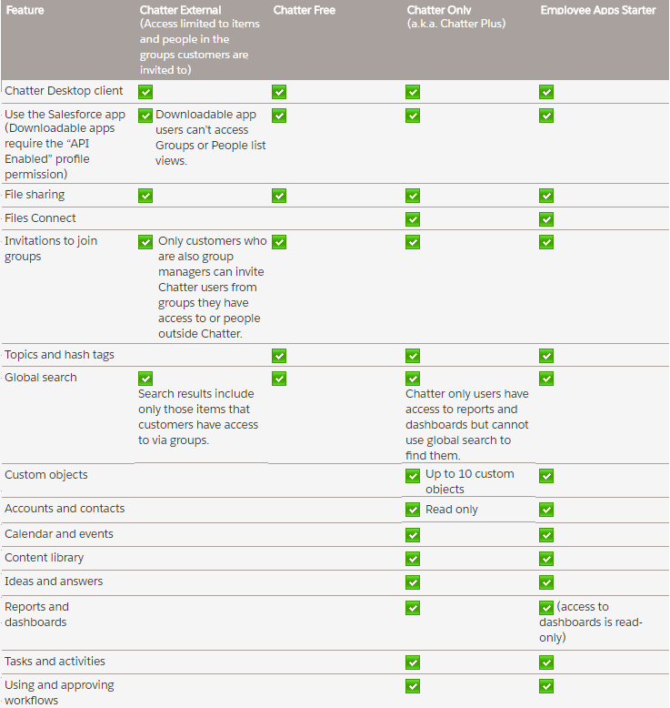
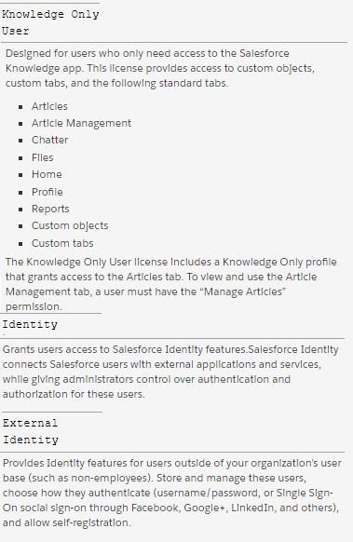
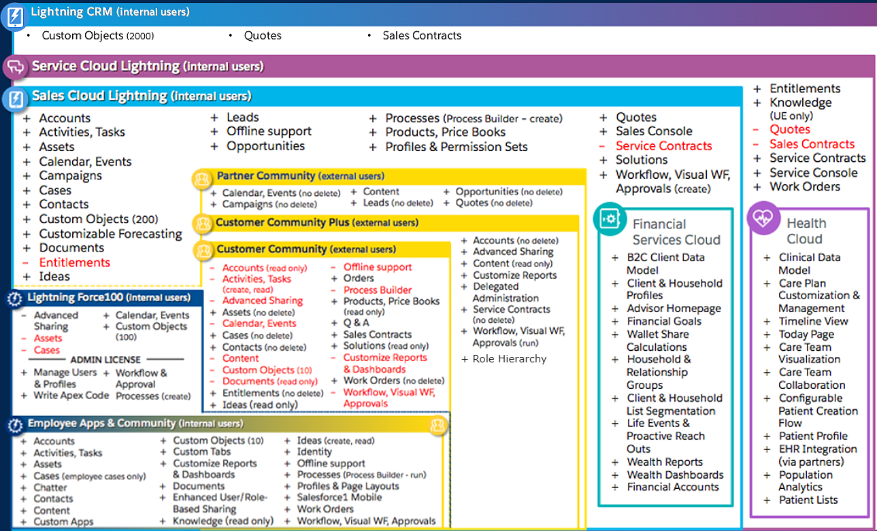
Salesforce Licenses
Chatter Licenses
Identity Licenses
Other Licenses

Slide 5
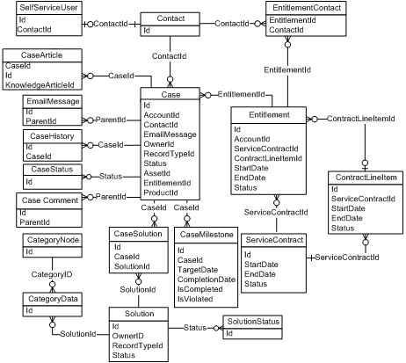
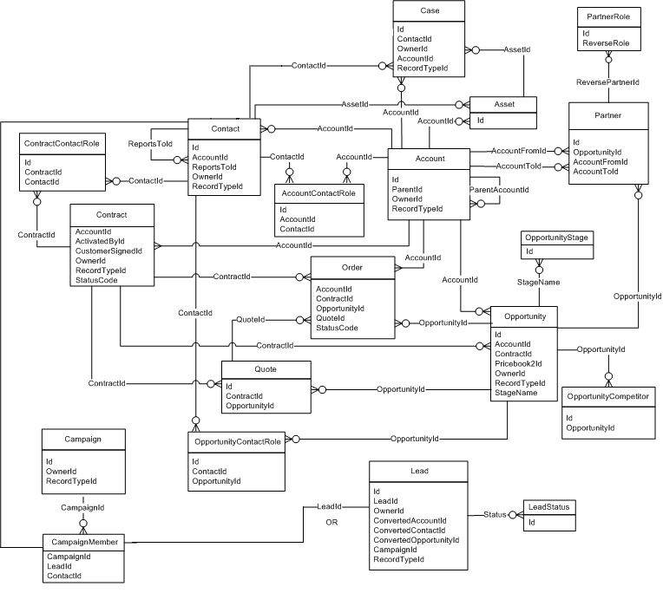
Salesforce Data Model

Slide 6
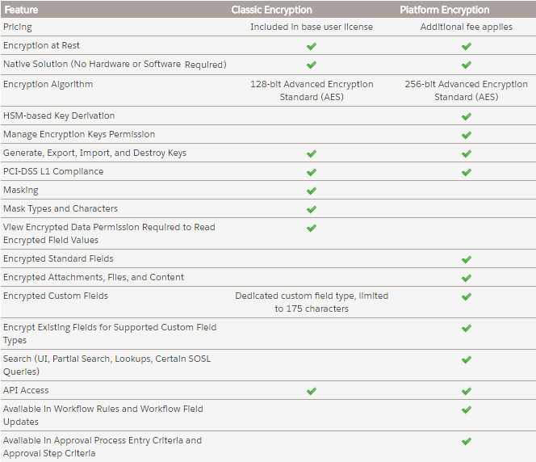
Encryption methods
CLASSIC ENCRYPTED FIELDS
Only Text (Encrypted) field type is supported
Only users with the permission “View Encrypted Data” can see data and clone th evalue
Cannot be unique, have an external ID, or have default values.
For leads are not available for mapping to other objects.
Are limited to 175 characters because of the encryption algorithm.
Are not available for: Salesforce Mobile Classic, Connect Offline, Salesforce for Outlook, lead conversion, workflow rule criteria or formulas, formula fields, outbound messages, default values, and Web-to-Lead and Web-to-Case forms.
Existing custom fields cannot be converted into encrypted fields nor can encrypted fields be converted into another data type.
SHIELD PLATFORM ENCRYPTION
Gives your data a whole new layer of security while preserving critical platform functionality.
Data stored in many standard and custom fields and in files and attachments is encrypted using an advanced HSM-based key derivation system
You can reference encrypted fields in most places in your flows and processes.
You can encrypt certain fields on the Account, Contact, Case, and Case Comment objects.
You can encrypt custom fields of type email. Phone, url , datetime and all text type fields
Only users with the “View Encrypted Data” permission can see the contents of encrypted fields
Not supported by many SF Apps (Heroku, SF CPQ, Data.com, Marketing Cloud)

Slide 7
Object relationship types
Master-detail
Closely links objects together such that the master record controls certain behaviors of the detail and subdetail record.
Detail and subdetail records inherit security settings and permissions from the master record. You can’t set permissions on the detail record independently.
The Owner field on the detail and subdetail records is not available and is automatically set to the owner of the master record. Custom objects on the “detail” side of a master-detail relationship can't have sharing rules, manual sharing, or queues, as these require the Owner field.
The master-detail relationship field (which is the field linking the objects) is required on the page layout of the detail and subdetail records.
Deleting a detail record moves it to the Recycle Bin and leaves the master record intact; deleting a master record also deletes related detail and subdetail records. Undeleting a detail record restores it, and undeleting a master record also undeletes related detail and subdetail records. However, if you delete a detail record and later, separately, delete its master record, you cannot undelete the detail record, as it no longer has a master record to relate to.
Lookup
Links two objects together. Lookup relationships are similar to master-detail relationships, except they do not support sharing or roll-up summary fields.
Can be required, prevent deletion and cascade delete if setup
External lookup
An external lookup relationship links a child standard, custom, or external object to a parent external object.
The standard External ID field on the parent external object is matched against the values of the child’s external lookup relationship field. External object field values come from an external data source.
Indirect lookup
Links a child external object to a parent standard or custom object.
When you create an indirect lookup relationship field on an external object, you specify the parent object field and the child object field to match and associate records in the relationship. Specifically, you select a custom unique, external ID field on the parent object to match against the child’s indirect lookup relationship field, whose values come from an external data source.
Hierarchical
A special lookup relationship available for only the user object. It lets users use a lookup field to associate one user with another that does not directly or indirectly refer to itself. For example, you can create a custom hierarchical relationship field to store each user's direct manager.
Many to many
Created by creating a junction object with 2 master-detail or lookup relationships

Slide 8
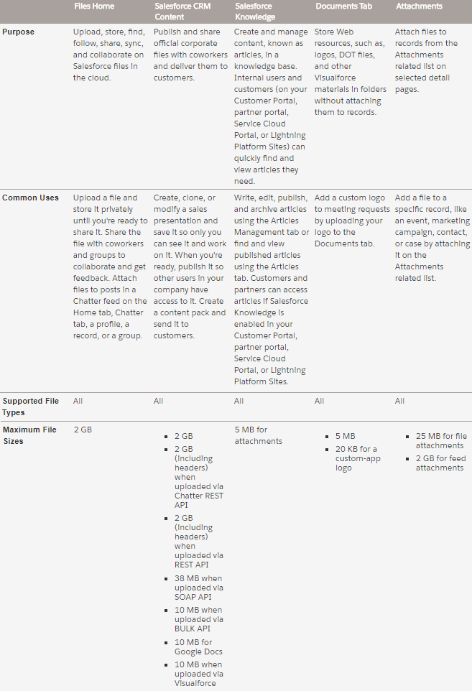
Different ways to manage files & content

Slide 9
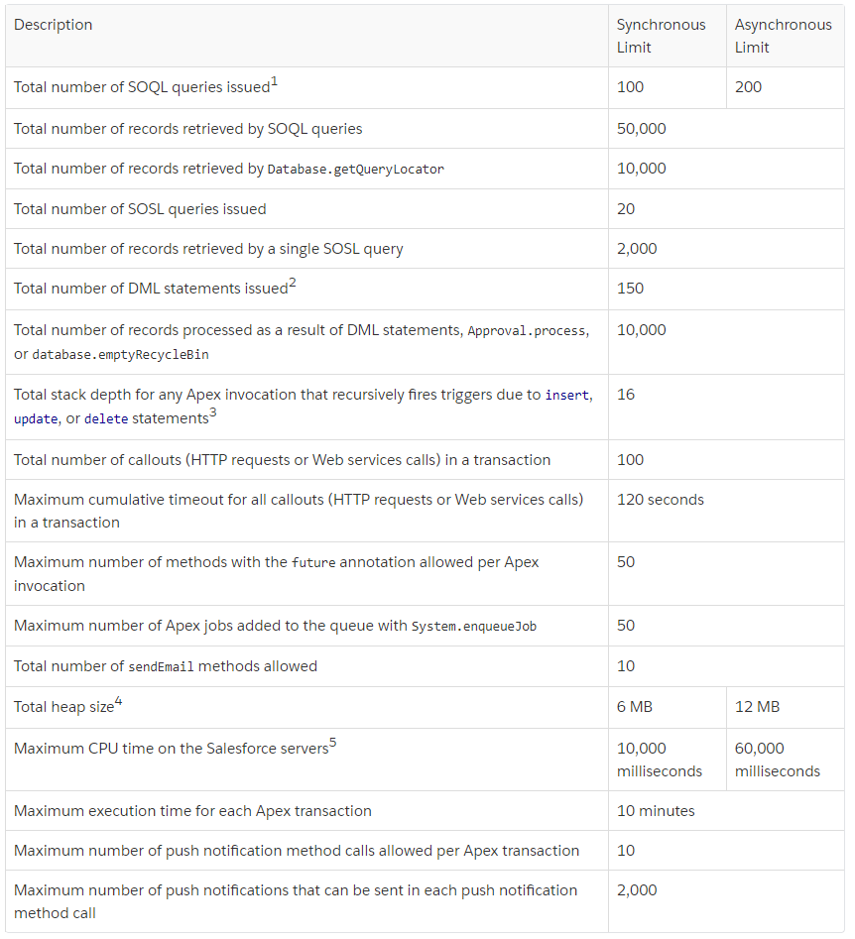
Apex transaction Limits

Slide 10
Organization strategy
An org strategy is a plan of how to best use Salesforce with your business. It outlines the underlying org architecture that will be used in your Salesforce solution. Two possible approaches:
Single-Org
Multi-Org
Approach | Pros | Cons
Single-Org | Cross business unit collaboration Salesforce Chatter shared in the organization Aligned processes, reports, dashboards, security – consolidated customization Ability to share data Unified reporting Single login to access multiple business functions 360 view from a central point of view – overall reports possible Interfaces are easier to maintain | Org complexity could become a barrier to progress Potential to hit specific Org limits, such as number of custom tabs, objects and code lines Org-wide settings could become difficult to govern and manage Time to market and innovate could be impacted by number of teams rolling out new functionality More teams updating shared configuration and code means more regression testing is needed as complexity increases over time Fewer sandbox environments reduces testing capabilities Local administration is difficult
Multi-Org | Logical Separation of data Reduced risk of exceeding Org limits Org-wide settings are easier to be governed and managed. Lower data volumes within a single Org – potentially improves performance Improved time to market and freedom to innovate Fewer teams impacted by shared updates Reduced complexity within a single Org More sandbox environments means more testing capabilities Local administration and customization possible | Harder to get a clear global definition of processes and data Less reuse of configuration and code Solutions for shared common business requirements need to be deployed into multiple Orgs Inferior collaboration across business units (no shared Chatter) Duplicated administration functions required Increased complexity for single sign on Merging/Splitting Orgs and changing integration endpoints is very difficult. The administration is extensive for configurations which cannot be deployed by automated processes. (deployment strategy needed)
The multi-org strategy can be declined in different approaches:
Complete Autonomy
each organization is not directly linked to each other environment
Master Child
a master org pushes a subset of data to all child linking organizations
No centralized org
each organization is directly linked to other organizations using Salesforce2Salesforce integration for exchanging and updating data

Slide 11
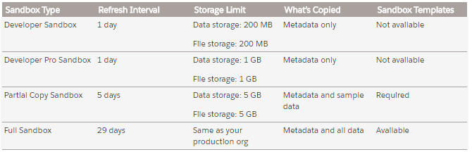
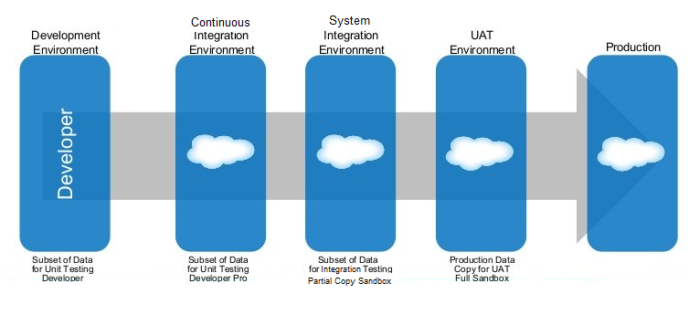
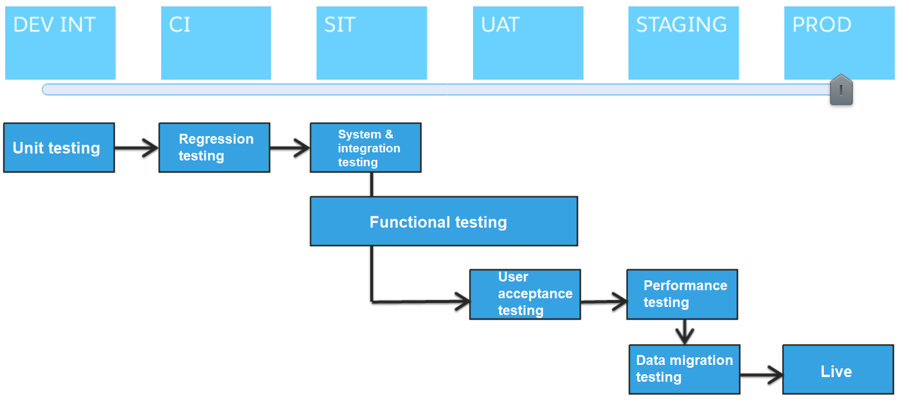
Sandbox strategy

Slide 12
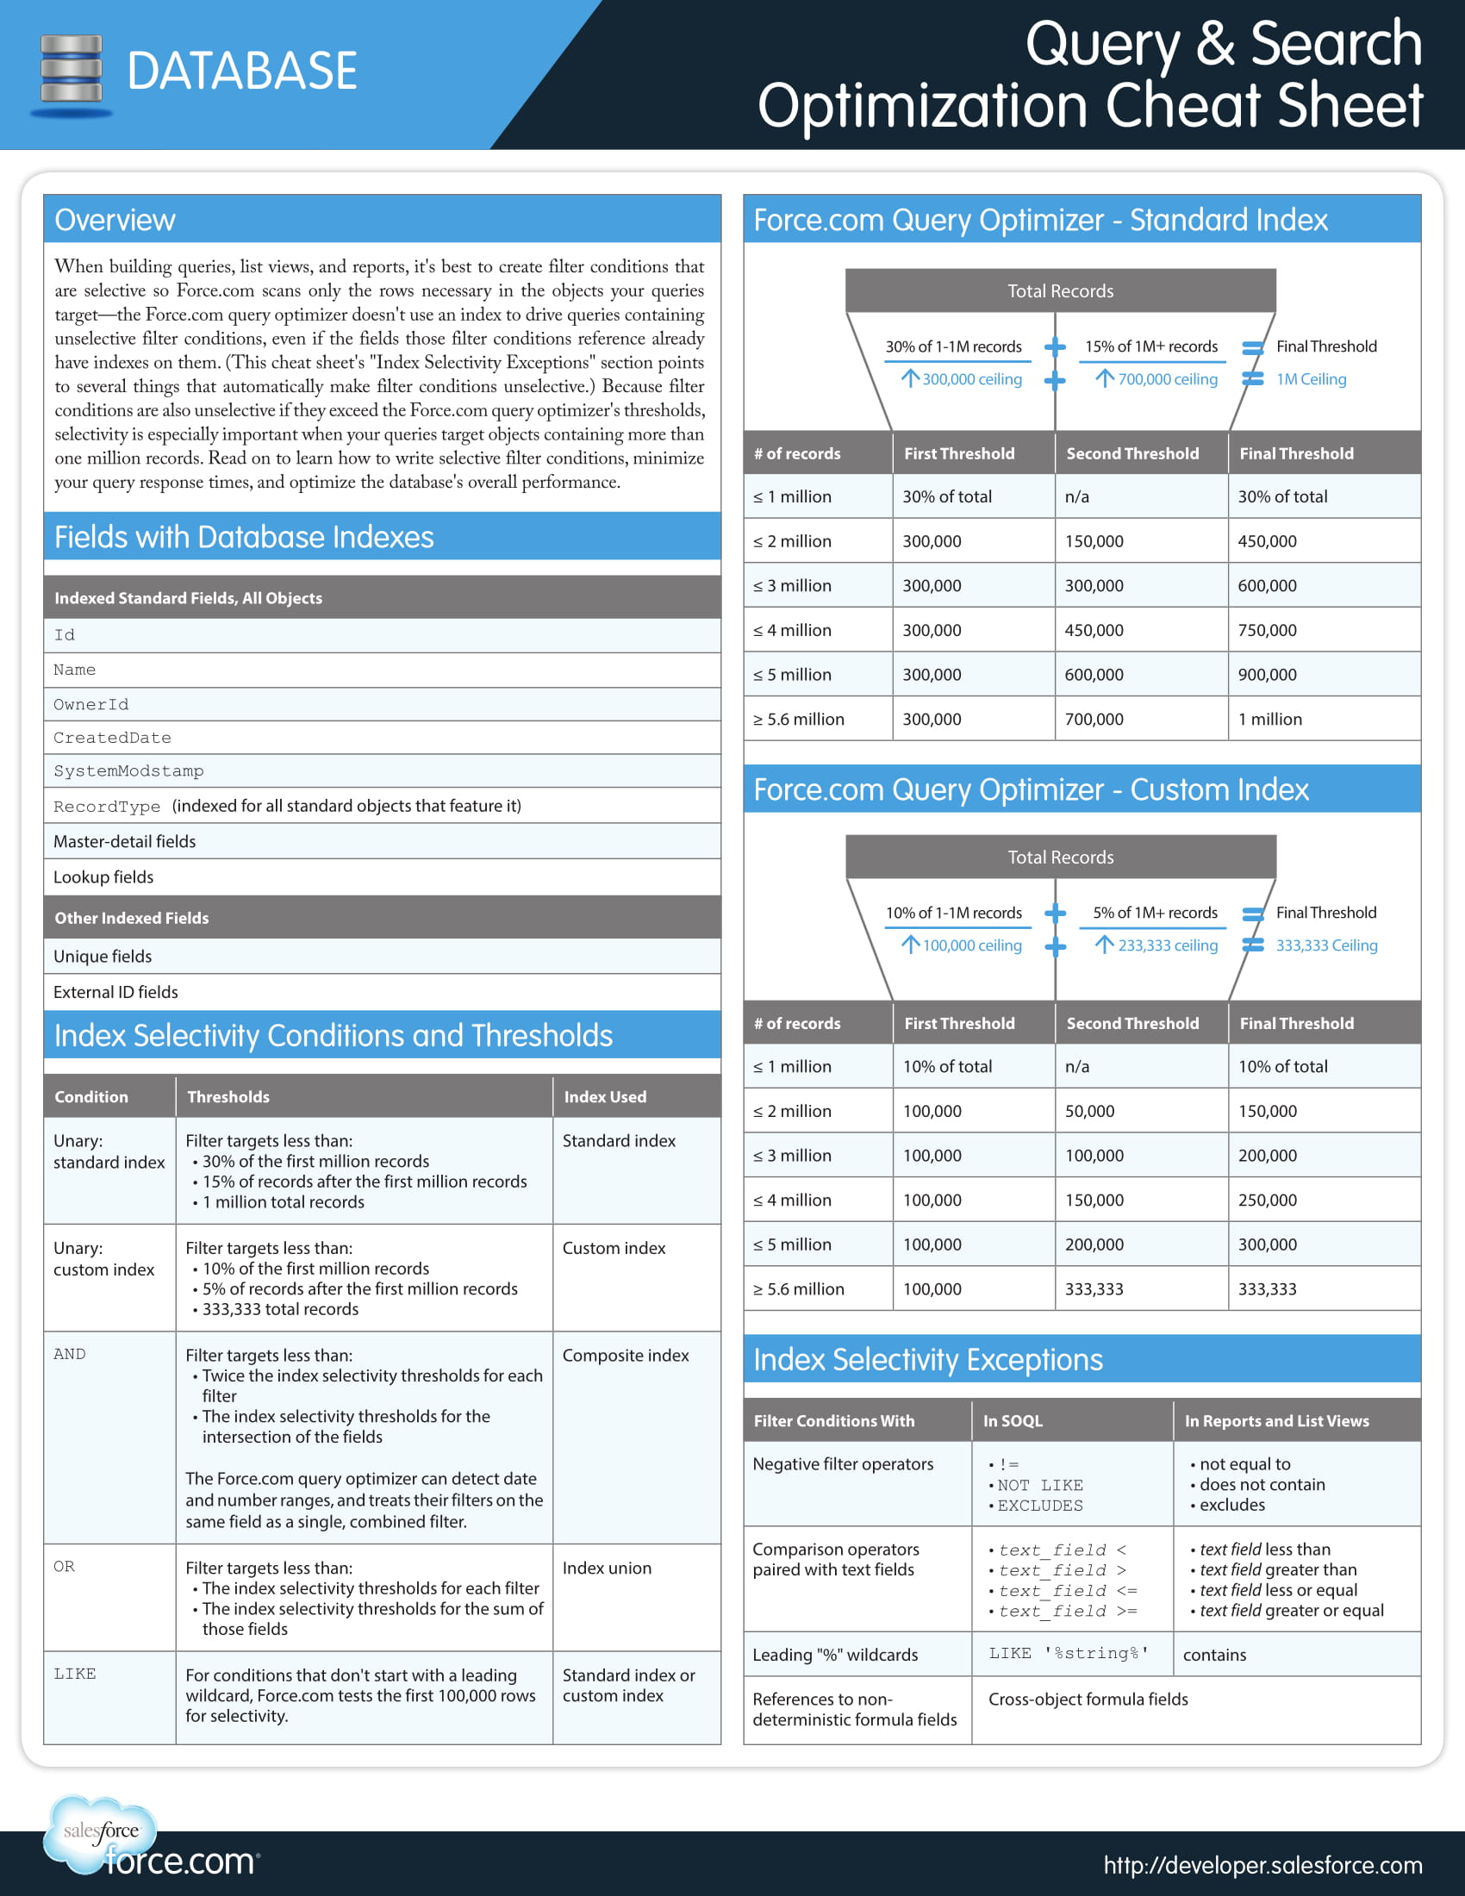

Slide 13
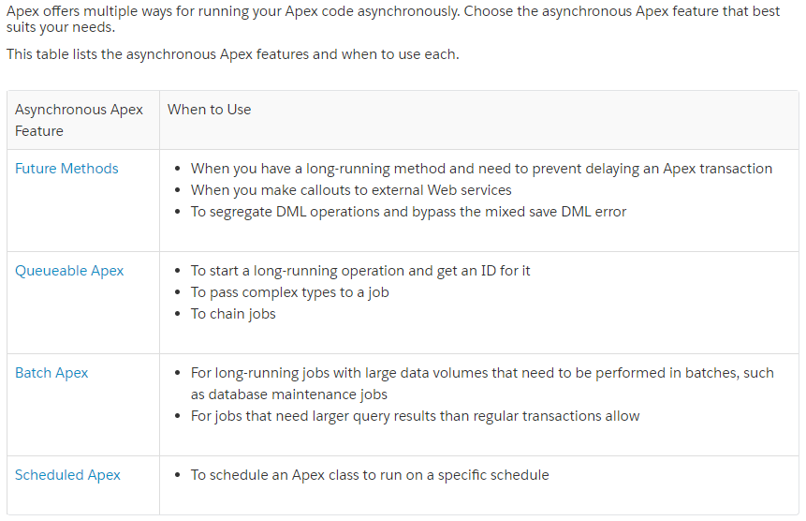
Asynchronous Apex
Apex Unit tests
At least 75% test coverage is required
Every trigger must have some test coverage.
All classes and triggers must compile successfully.
Classes and methods defined as @isTest can be either private or public.
Classes defined as @isTest must be top-level classes and can't be interfaces or enums.
Methods of a test class can only be called from a running test, that is, a test method or code invoked by a test method, and can't be called by a non-test request.
Test methods can’t be used to test Web service callouts. Instead, use mock callouts. (Test.setMock + HttpCalloutMock, WebServiceMock interface)
You can use @testVisible to enable access to private methods
Annotate your test class or test method with IsTest(SeeAllData=true) to open up data access to records in your organization.
Use test setup methods (methods that are annotated with @testSetup) to create test records once and then access them in every test method in the test class.
The runAs method enables you to write test methods that change the user context to an existing user or a new user so that the user’s record sharing is enforced. You can also use the runAs method to perform mixed DML operations in your test by enclosing the DML operations within the runAs block.
You can use Test.startTest and Test.stopTest to manage governor limits consumption

Slide 14
Deployment methods
Tool | Best for | Limitations
Change Sets | Straight sandbox to production migrations Change management without using a local file system Auditing previously deployed changes Enforcing code migration paths Deploying the same components to multiple orgs
Ant Migration Tool | Development projects for which you need to populate a test environment with a lot of setup changes—Making these changes using a web interface can take a long time. Multistage release processes—A typical development process requires iterative building, testing, and staging before releasing to a production environment. Scripted retrieval and deployment of components can make this process much more efficient. Repetitive deployment using the same parameters—You can retrieve all the metadata in your organization, make changes, and deploy a subset of components. If you need to repeat this process, it’s as simple as calling the same deployment target again. When migrating from stage to production is done by IT—Anyone that prefers deploying in a scripting environment will find the Ant Migration Tool a familiar process. Scheduling batch deployments—You can schedule a deployment for midnight to not disrupt users. Or you can pull down changes to your Developer Edition org every day.
Force.com IDE | Project-based development Deployment to any org Synchronizing changes Selecting only the components you need | Some setup required Not always upgraded at the same time as other Salesforce products Repeatable deployments require re-selecting components, which can be time consuming and introduce errors
Force.com Workbench | Ad hoc queries Deploy or retrieve components with a package.xml file Metadata describes Lightweight data loads | Not an officially supported product No project management features
Force.com CLI | Scripted commands and automated tasks When your security policies dictate that passwords must not be stored on disk; forces interactive login | Logging in can be difficult behind a firewall
Unmanaged Packages | One-time setup of a development environment A starting point configuration that can be customized | You can’t make further changes to packaged components using subsequent packages Requires a Developer Edition org
Managed Packages | Commercial applications Functionality you want to add in multiple, possibly non-related orgs | Access to code is limited or hidden Unique namespace can be bothersome or a blocker Difficult to modify or delete components Requires a Developer Edition org

Slide 15
Support multiple languages
An administrator can enable multiple languages in setup. Every language has to be enabled separately
Standard objects and fields are translated automatically and translations can be edited in „Rename tabs & labels” interface
Use Translation Workbench to maintain your translated labels in your org. You can manage translated values for any Salesforce supported language.
Almost everything can be translated including object names, field labels, picklist values, validation messages, etc.
If a customized component doesn’t have a translated value, the component uses the org’s default language. When you deactivate a language, all translations for that language are still available in the Translation Workbench, but users with that language selected see the org’s default language values.
Translations can be exported and imported from a file
Multi-Currency
By default, Salesforce organizations use a single currency. Once you set the required currency locale in your company settings, all currency values on records display in that currency.
Once you activate multicurrency for your org, you can specify which currencies are supported by activating or deactivating them
Every record has a Currency field that specifies the currency type for amounts in that record. All currency amounts display in the record’s currency and are also converted to the personal currency of the record owner, based on the conversion rates entered by your administrator. Amounts in the user’s personal currency are displayed in parentheses
Amounts in reports are shown in their original currencies, but can be displayed in any active currency
An administrator can modify conversion rates in Setup. By default, previous conversion rates are not stored and all conversions within opportunities, forecasts, and other amounts use the current conversion rate.
Advanced currency management allows you to manage dated exchange rates within opportunities using Salesforce
Dated exchange rates are used for opportunities, opportunity products, opportunity product schedules, campaign opportunity fields, opportunity splits, and reports related to these objects and fields. Dated exchange rates are not used in forecasting, currency fields in other objects, or currency fields in other types of reports.
Cross-object formulas always use the static conversion rate for currency conversion.
Protecting Custom Sharing Code
Sharing records with „Manual” row cause sharing reason are deleted on record owner change
Sharing records via custom code can be protected by:
Using Apex Sharing Reasons (supported on custom objects only)
Using Outbound Messaging to external system which will restore sharing
Using a Trigger which calls an Assignment engine built on Salesforce (CoreSite SM)
Using a Shadow Sharing Table with a trigger

Slide 16
Testing Types
Testing type | Description | When & where
Unit testing | The process of testing each unit of code in a single component. This testing is carried out by the developer as the component is being developed. | During development on a developer environment
Code review | Systematic examination of computer source code. It is intended to find mistakes overlooked in software development, improving the overall quality of software. Reviews are done in various forms such as pair programming, informal walkthroughs, and formal inspections. | At the moment of merging, commiting code on a developer environment
Functional Testing | A type of black-box testing that bases its test cases on the specifications of the software component under test. Functional testing usually describes what the system does. | After development of a certain piece of functionality, on the QA environment
Integration testing | Testing the interface between the modules; it can be top down, bottom up, big bang. | After merging multiple functionalities or features on the CIT environment
System Integration testing | A high-level software testing process in which testers verify that all related systems maintain data integrity and can operate in coordination with other systems in the same environment. The testing process ensures that all subcomponents are integrated successfully to provide expected results. | SIT phase on the SIT environment
User Acceptance testing | Last phase of the software testing process. During UAT, actual software users test the software to make sure it can handle required tasks in real-world scenarios, according to specifications. | UAT phase on the UAT environment
Performance testing | Includes Stress and Load testing. Coordinated with Salesforce,. Done using LoadRunner, SilkPerformer, Red View, ... | Scheduled during development, SIT, UAT
Smoke testing | Preliminary testing to reveal simple failures severe enough to reject a prospective software release | After deployment to any environment
Regression testing | A type of software testing that ensures that previously developed and tested software still performs the same way after it is changed or interfaced with other software | After deployment to any environment
Data migration testing | Testing that data is correctly migrated and that data integrity is maintained between systems. | UAT or Staging phase on the UAT or Staging environment

Slide 17
Salesforce Sharing Methods
Method | Description
Profiles | A profile is a group/collection of settings and permissions that define what a user can do in salesforce. A profile controls “Object permissions, Field permissions, User permissions, Tab settings, App settings, Apex class access, Visualforce page access, Page layouts, Record Types, Login hours & Login IP ranges.
Permission Sets | Very similar to profile. The main difference between these two is that user can have only one profile and can have multiple permission sets at time. In such case, most permissive setting applies.
Organization Wide Defaults | Organization-wide sharing defaults set the baseline access for your records. Options include Private, Public Read Only, Public Read/Write and Controlled By Parent
Role Hierarchy | Represents a level of data access that a user or group of users needs. Users assigned to roles near the top of the hierarchy get to access the data of all the users who fall directly below them in the hierarchy.
Sharing rules | Automatic exceptions to your organization-wide sharing settings for defined sets of users. Standard way to open up record access.
Sharing Sets | Grants high-volume users access to any record associated with an account or contact that matches the user’s account or contact. You can also grant access to records via access mapping in a sharing set, which supports indirect lookups from the user and target record to the account or contact. For example, grant users access to all cases related to an account that’s identified on the users’ contact records.
Sharing Groups | Allow you to share records owned by high-volume community users with internal and external users in your communities.
Partner Super Users | Partner Super Users have access to data owned by their peers (same role). Partner super user access applies only to cases, leads, custom objects, and opportunities.
Public Groups | A group consists of a set of users. A group can contain individual users, other groups, or the users in a particular role or territory. It can also contain the users in a particular role or territory plus all the users below that role or territory in the hierarchy.
Queues | Queues help you prioritize, distribute, and assign records to teams who share workloads. Queue members and users higher in a role hierarchy can access queues from list views and take ownership of records in a queue. Use queues to route lead, order, case, and custom object records to a group.
Teams | For accounts, opportunities, and cases, record owners can use teams to allow other users access to their records. A team is a group of users that work together on an account, sales opportunity, or case. Record owners can build a team for each record that they own. The record owner adds team members and specifies the level of access each team member has to the record, so that some team members can have read-only access and others can have read/write access. The record owner can also specify a role for each team member, such as “Executive Sponsor.” In account teams, team members also have access to any contacts, opportunities, and cases associated with an account.
Terrirory management | An account sharing system that grants access to accounts based on the characteristics of the accounts
Implicit sharing | Sharing not configured by administrators; it is defined and maintained by the system to support collaboration among members of sales teams, customer service representatives, and clients or customers. Includes Parent, Child, Portal and High Volume
Manual sharing | Sharing done directly by record owners by clicking the Share button
Apex managed sharing | Sharing generated through Apex by creating records in the Sharing objects

Slide 18
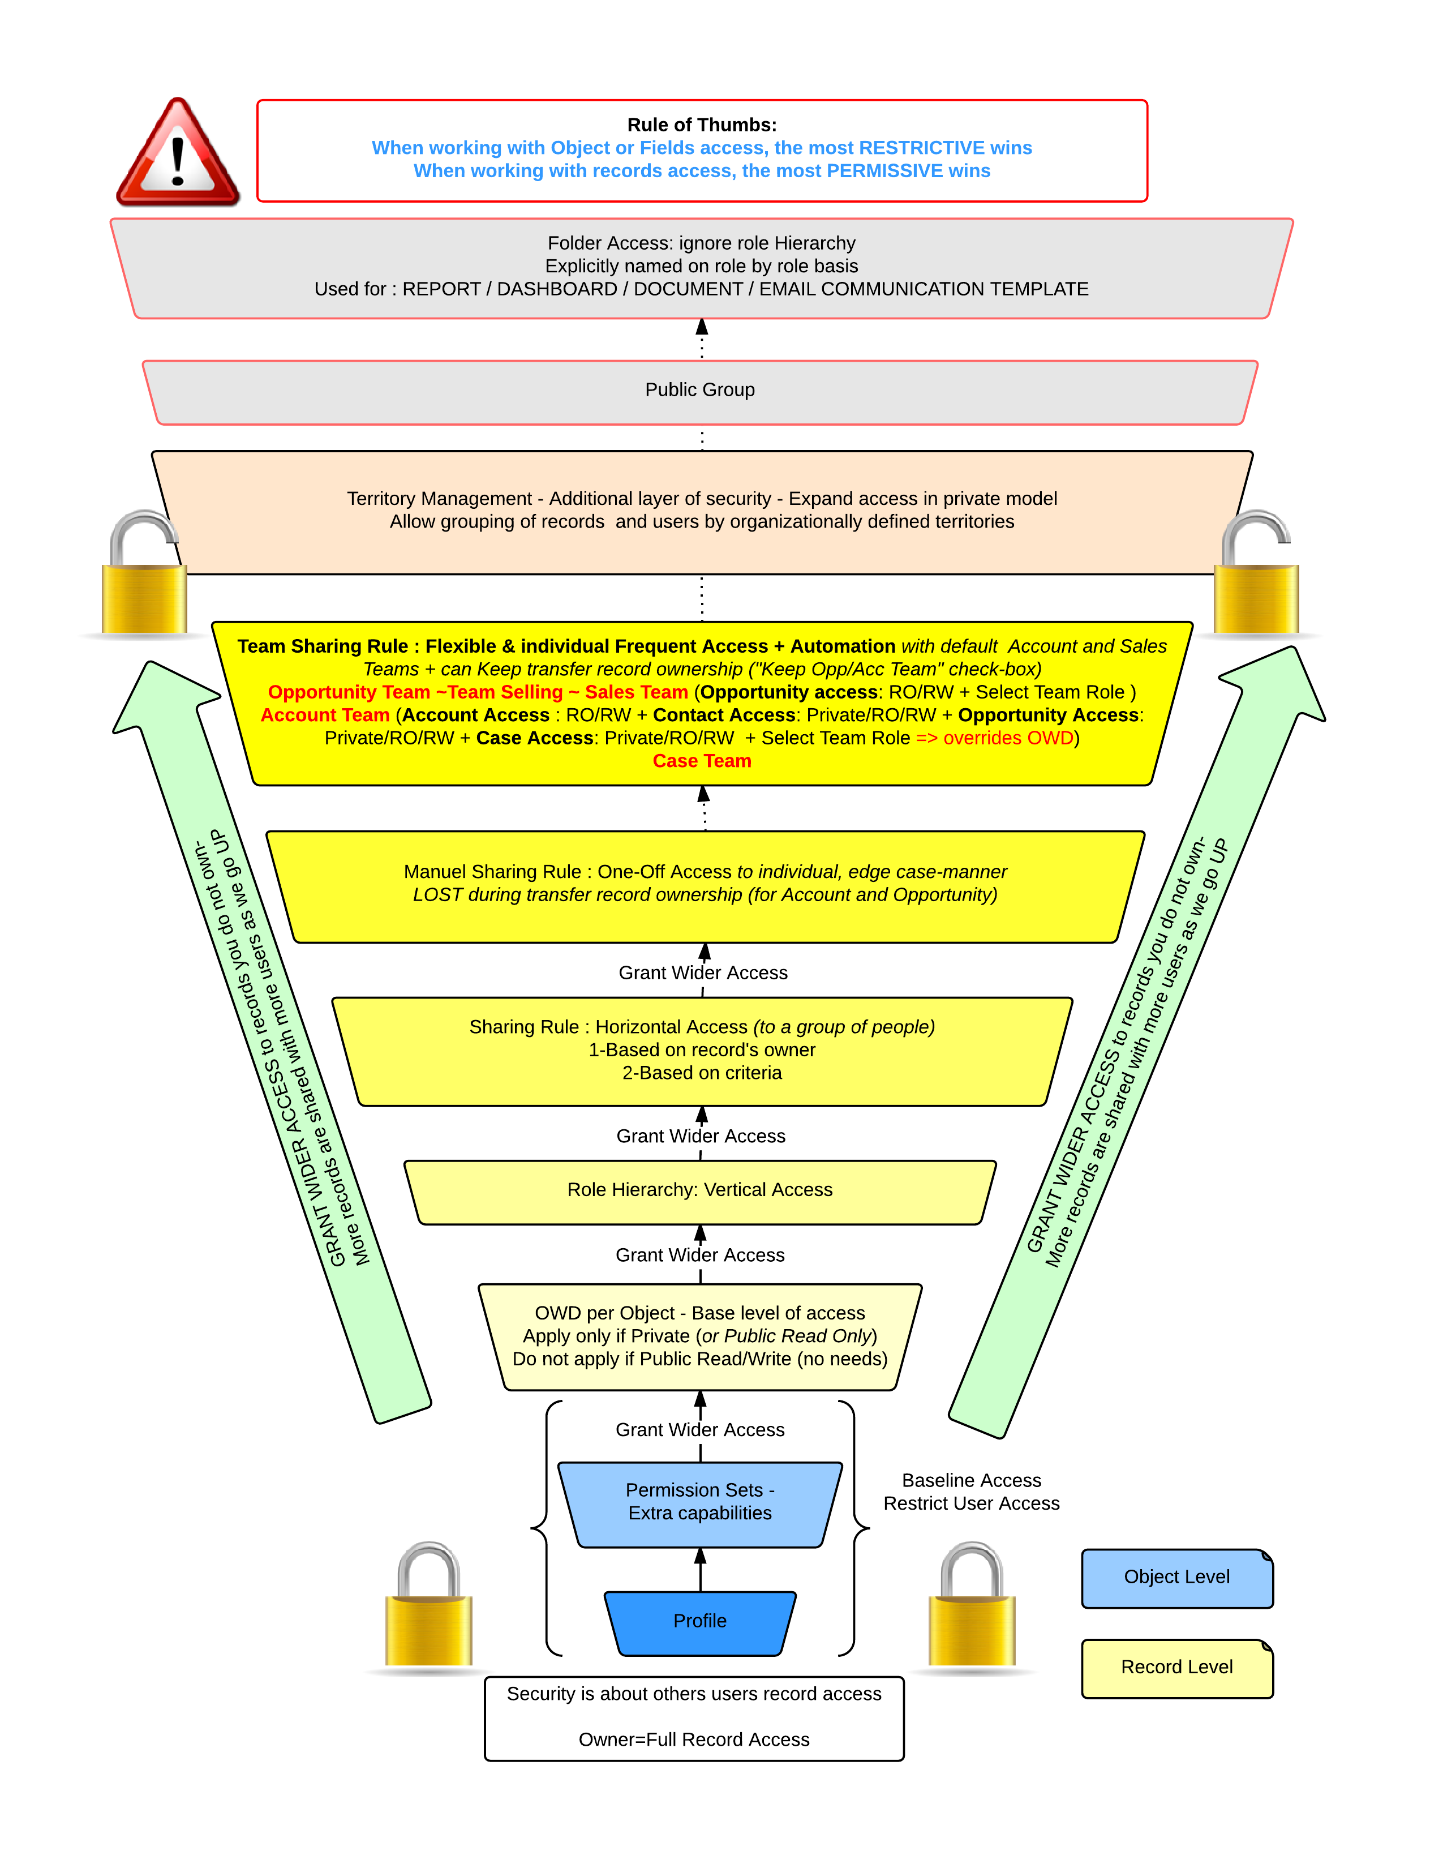
Salesforce Sharing Illustrated

Slide 19
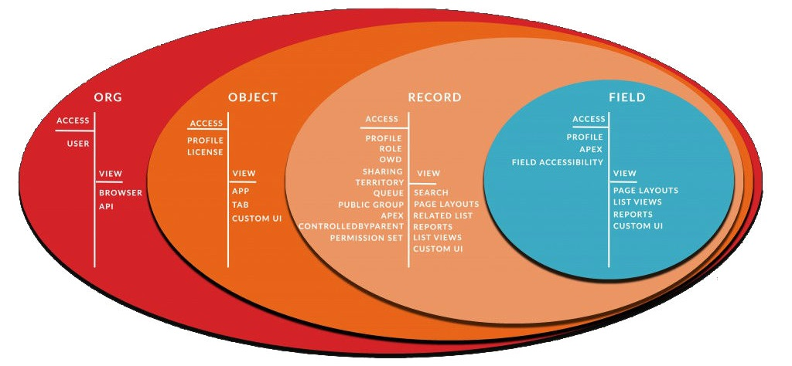
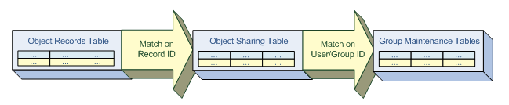
Sharing Architecture
Restricting Org Access
Method | Description
My domain | Select a login policy to prevent users from logging in with the generic https://<instance>.salesforce.com/ login page and then being redirected to your subdomain URLs after login. Supports branding and SSO.
Login IP ranges | Control login access at the user level by specifying a range of allowed IP addresses on a user’s profile. When you define IP address restrictions for a profile, a login from any other IP address is denied.
Login IP hours | Specify the hours when users can log in based on the user profile.
Two-Factor Authentication | For each profile, you can require a verification code (also called a time-based one-time password, or TOTP) instead of the standard security token. Users connect an authenticator app that generates verification codes to their account.
Trusted IP Ranges | Define a list of IP addresses from which users can log in without receiving a login challenge for verification of their identity, such as a code sent to their mobile phone or token.

Slide 20
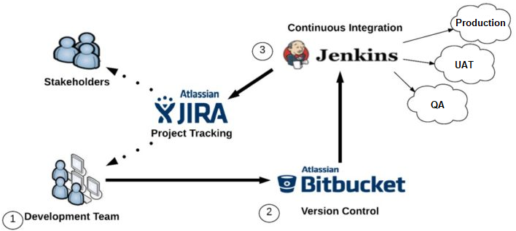
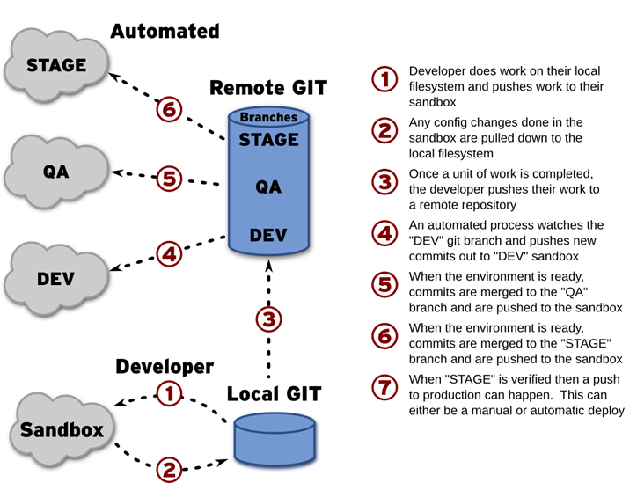
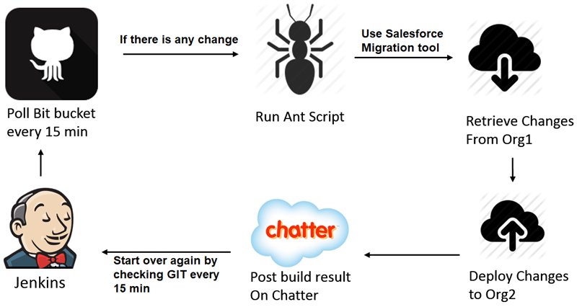
Continuous Integration Strategy & tools

Slide 21
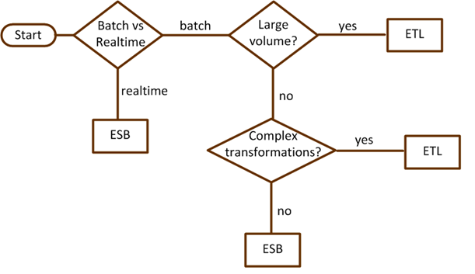
ETL & ESB integration
ETL tools support the process of Extracting, Transforming and Loading large volumes of data from multiple data sources. Used for batcch, scheduled or ad-hoc data operations. They can be used to perform data migration or data integration. Some examples include Talend, Informatica, Jitterbit, Data migrator, etc.
An enterprise service bus (ESB) is a middleware tool used to distribute work among connected components of an application. ESBs are designed to provide a uniform means of moving work, offering applications the ability to connect to the bus and subscribe to messages based on simple structural and business policy rules. The most often used ESB is MuleSoft.
When to use ESB:
When system integration points grow beyond two, with additional integration requirements.
When using multiple protocols such as FTP, HTTP, Web Service, and JMS etc.
When there is a requirement for message routing based on message content and similar parameters.
How an ESB architecture maps to our five core integration principles:
Orchestration: Composing several existing fine-grained components into a single higher order composite service. This can be done to achieve appropriate "granularity" of services and promote reuse and manageability of the underlying components.
Transformation: Data transformation between canonical data formats and specific data formats required by each ESB connector. An example of this would be transforming between CSV, Cobol copybook or EDI formats to either SOAP/XML or JSON. Canoncial data formats can greatly simplify the transformation requirements associated with a large ESB implementation where there are many consumers and providers, each with their own data formats and definitions.
Transportation: Transport protocol negotiation between multiple formats (such as HTTP, JMS, JDBC). Note: Mule treats databases like another "service" by making JDBC just another transport (or endpoint) where data can be accessed.
Mediation: Providing multiple interfaces for the purpose of a) supporting multiple versions of a service for backwards compatibility or alternatively, b) to allow for multiple channels to the same underlying component implementation. This second requirement may involve providing multiple interfaces to the same component, one legacy interface (flat file) and one standards compliant (SOAP/XML) interface.
Non-functional consistency: For a typical ESB initiative, this can include consistency around the way security and monitoring policies are applied and implemented. Additionally, the goals of scalability and availability can be achieved by using multiple instances of an ESB to provide increased throughput (scalability) and eliminate single-points-of-failure (SPOFs), which is the key objective for highly available systems.

Slide 22
Account models
B2C account models
Model | Description
Person Accounts | Person accounts store information about individual people by combining certain account and contact fields into a single record. Has some limitations and can not be reverted.
Private Contact | Allows Contacts to be created without accounts. Not recommended as an B2C model
Household model | The standard Salesforce Account object acts as the household, with numerous contacts and opportunities associated with it. Default and recommended for NPSP.
1-to-1 Account Model | Works by creating an Account object for each Contact you create. The Account is automatically created when you create a Contact, and the name of the new Account is identical to the name of the new Contact. The Account object itself, however, acts "invisibly" behind the scenes, and exists for the sole purpose of conforming to the standard Salesforce Account model (which requires all Contacts be associated with an Account).
The Bucket model | All Contacts are associated with a single Account, as if all of your contacts have been dumped in one "bucket".
Account Hierarchy models
Model | Description
Global Enterprise Account | Establish one global account and link all contacts, opportunities, cases, and so on to that single overarching account. Using one global account makes it easy to find that account’s records and to report on that account at the enterprise level. But it’s harder to manage a large mass of information, and not being able to easily view the big picture might make it hard to see what each location needs from you for your relationship to be successful.
Location-Specific Accounts | Establish accounts for each location and create contacts, opportunities, cases and so on separately for each location. With this option, you maintain more accounts and need to set up a few more complex reports to get the big picture. But using multiple accounts means you can take advantage of account ownership, hierarchies, specific sharing settings, and more granular reporting. You can also more easily track and report on opportunities, cases, and other interactions for each account.
Contacts to multiple Accounts models
Model | Description
Account Contact Roles | Standard salesforce solution. Does not support custom fields, layouts, validation, workflow, triggers, record types, field history, etc. Sharing is derived from Account.
Contacts to Multiple Accounts | Standard salesforce solution. Supports custom fields, layouts, validation, workflow, triggers, etc. Supports record types and field history. Sharing is derived from Account and Contact
Custom Junction Object | Create a custom object to connect a Contact with multiple Accounts. Supports all features, but requires custom development.

Slide 23
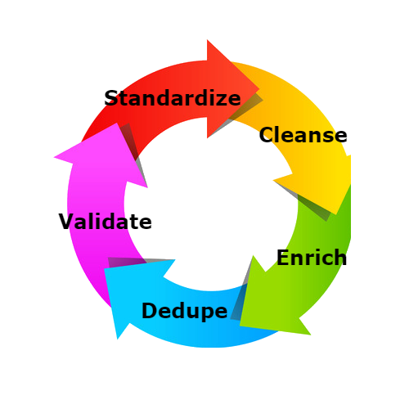
Data migration & Backup
Data Loading best practices:
Use BULK API for more that a few thound records
Use the fastest operation Insert > Update > Upsert
Use Public Read/Write security to avoid sharing calculation
Disable triggers, workflow rules and validation
Some fields might be transformed during migration (id, autonumber, audit fields)
When changing child records, group them by parent Id
Use defer-sharing
Activate sharing rules after loading and one at a time
Audit fields can be populated only on insert.
Backup types:
Full
Incremental
Partial
Data archiving options:
BigObject
Outside of Salesforce
Weekly export
Data loader
Reporting snapshot
Data governance & stewardship
Data governance is a process to ensure usability, quality, and policy compliancce of the data asset. It includes business definitions, data quality and security rules, supports UI and integration design.
It defines what is collected, how is it kept secured, who can CRUD, what quality rules are there, how available and usable is the data, ...
Data stewardship is a cross-functional tactical role and activities to ensure adherence to data governance rules and spirit. It includes data quality monitoring, work flow, and maintenance.
Mastar data management is the effort made by an organization to create one single master reference source for all critical business data, leading to fewer errors and less redundancy in business processes. It consists of 3 pillars: Mastering data, Mastering data relationships and Mastering events.
Understand the linear flow of data:
How are records generated?
Why are they created?
What are they used for?
What is reported on?
Where is the hand-off?

Slide 24
Methods to provision users
Method | Description
Manual provisioning | A user is created manually by an administrator.
API provisioning | Provision users by using the SOAP or REST API on the User object.
Programmatic provisioning | Povision users in Apex code.
JIT provisioning with SAML | Use a SAML assertion to create regular and portal users on the fly the first time they try to log in. This eliminates the need to create user accounts in advance. A user is created when he logs in via SSO.
Mass user provisioning | Create a large number of users by using Bulk API, Data Loader or an ETL tool.
Identity connect with AD | Integrates Microsoft Active Directory (AD) with Salesforce. User information entered in AD is shared with Salesforce seamlessly and instantaneously. Companies that use AD for user management can use Identity Connect to manage Salesforce accounts. Changes in AD are reflected in Salesforce in near real time.
Self-registration | Users can self-register when first visiting the site. Works with community users only.
Social sign-on provisioning | Users can sign in using a social site credentials. Supported sites include LinkedId, Facebook, Twitter, Google, Janrain, Salesforce, and any srevice who implements the OpenID Connect protocol or Oauth. Works with community users only.
Single Sign On Methods
Method | Description
SSO with multiple Orgs | SSO between multiple Salesforce orgs. Can be enabled in Setup for both orgs. Works only with internal users.
SSO with AD | Salesforce is integrated with AD using Identity Connect or ADFS
Social Sign On | Sign on via a Social site credentials. Works with community users only.
Federated Authentication | The platform receives a SAML assertion in an HTTP POST request. The SAML assertion has a limited validity period, contains a unique identifier, and is digitally signed. If the assertion is still within its validity period, has an identifier that has not been used before, and has a valid signature from a trusted identity provider, the user is granted access to the application. If the assertion fails validation for any reason, the user is informed that their credentials are invalid.
Delegated Authentication | An internal WS authenticates users. It receives an username, password and sourceIP and returns true or false.
*Never enable SSO for Admin users

Slide 25
Data quality and duplicate management
Data quality attributes:
Age
Completeness
Accuracy
Consistency
Duplication
Usage
Best data quality and archiving policy is defined at design time.
Use data quality scoring and reporting.
How to safely delete data:
Isolate suspects
Flag for elimination and color code
Hide with security
Wait (around 3 months)
Backup
Delete
Deduplication step order:
Accounts vs Accounts
Contacts within Account
Contacts between Accounts
Accounts vs Accounts
Leads
Leads to Contacts
Data quality tools:
Data.com (works on Accounts, Contacts, and Leads)
Duplicate rules (works on Account, Lead, Contact, and Custom object)
Merging records (works on Accounts, Contacts, and Leads)
Archival strategy options:
In place archiving – Storage objects, record archived indicator
External archiving – on premise DWH, external cloud solution ,flat file archiving
Hybrid solution – data tiering

Slide 26
Two factor Authentication
As a Salesforce admin, you can enhance your org’s security by requiring a second level of authentication for every user login. You can also require two-factor authentication when a user meets certain criteria, such as attempting to view reports or access a connected app.
When a user logs in from outside a trusted IP range and uses a browser or app we don’t recognize, the user is challenged to verify identity. We use the highest-priority verification method available for each user. In order of priority, the methods are:
Verification via push notification or location-based automated verification with the Salesforce Authenticator mobile app (version 2 or later) connected to the user’s account.
Verification via a U2F security key registered with the user’s account.
Verification code generated by a mobile authenticator app connected to the user’s account.
Verification code sent via SMS to the user’s verified mobile phone.
Verification code sent via email to the user’s email address.
Login Flows
After identity verification is successful, the user doesn’t have to verify identity again from that browser or app, unless the user:
Manually clears browser cookies, sets the browser to delete cookies, or browses in private or incognito mode
Deselects Don’t ask again on the identity verification page
Managed packages to propose
Use Case | Package/solution
Document generation | Conga Composer WebMerge Drawloop
eSignature | Docusign EchoSign
ESB | Mulesoft
CPQ | Salesforce CPQ CloudSense CPQ
Marketing | Marketing Cloud Marketo
Accounting | FinancialForce Intaact
Analytics | Wave analytics
Cloud Data storage and long operations | Heroku AWS
Document Storage | Box Google Drive SharePoint DropBox CRM Content

Slide 27
Mobile Strategy Decision
 | Native | HTML5 | Hybrid | Salesforce App
Graphics | Native APIs | HTML, Canvas, SVG | HTML, Canvas, SVG | Standard Salesforce + Visualforce
Performance | Fast | Slow | Slow | Slow
Native look and feel | Native | Emulated | Emulated | Emulated(VF)
Distribution | Appstore | Web | Appstore | Appstore
Camera | Yes | No | Yes | No
Notifications | Yes | No | Yes | No
Contacts, Calendar | Yes | No | Yes | Yes
Offline storage | Secure file storage | Shared SQL | Secure file system, shared SQL | Yes
Geolocation | Yes | Yes | Yes | Yes
Swipe | Yes | Yes | Yes | Yes
Pinch, spread | Yes | No | No | No
Connectivity | Online and offline | Mostly online | Online and offline | Mostly online
Development skills | ObjectiveC, Java | HTML5, CSS, Javascript | HTML5, CSS, Javascript | Visualforce
Cross-Platform | No | Yes | Yes | Yes
Easy to deploy | No | Yes | No | Yes
Fully customisable UI | Yes | Yes | Yes | No
Speed of Development | Slow | Medium | Medium | Fast

Slide 28
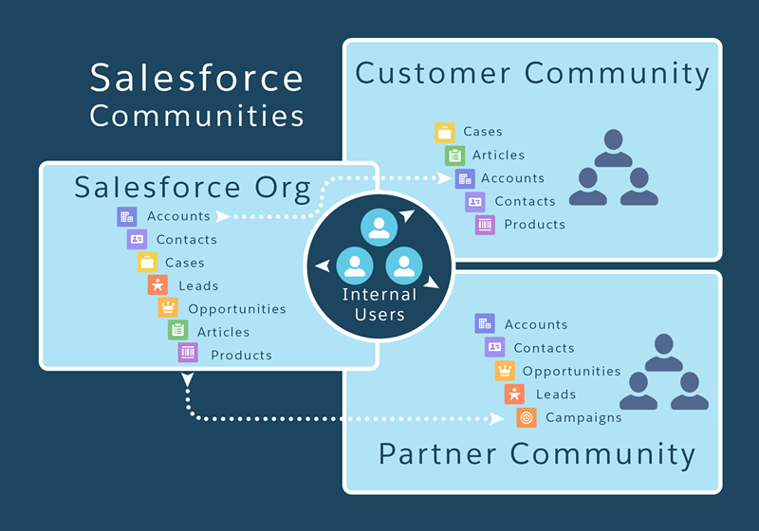
Salesforce Communities
Community templates:
Visualforce + Tabs
Customer Service (Napili)
Kokua & Koa
Lightning Communities
Partner Central
Customer Account Portal
Rollout Strategy phases:
Establish
Manage
Engage
Measure
Branding options:
Select color scheme
Customize emails
Logo
Login page
Custom domain (my domain)

Slide 29
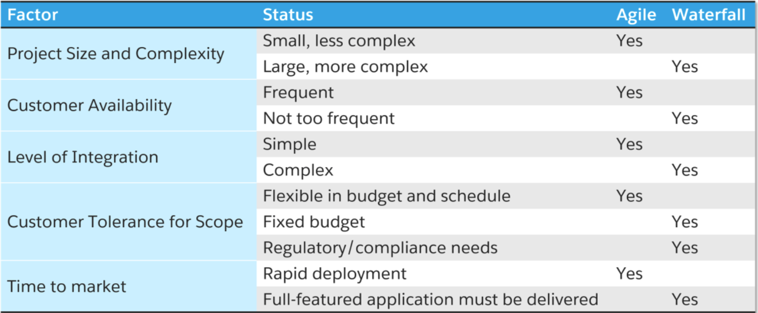
Project methodology
Agile vs Waterfall
Methodology Artifacts
Centralized Communication/Collaboration/Documentation repository
Requirements management from Business Requirements traced all the way through test cases and deployed technical components
Governance levels (Steering committee, Center of Excellence, Architectural Review board with a detailed understanding of interdependency between groups)
Quality Control (Development of Technical Design Standards, Common Usability Requirements, Peer Review, Code Review, Deployment checklist, etc.)
Thorough testing strategy with as much automation that can reasonably be built
Dependency management through PMO, scrum teams, scrum of scrums, status reports, risk & issue management
Key Tools:
Project management software (MS Project, Agile Accellerator)
Requirements Repository (Rally, Jira, Excel)
Traceability Matrix
Test Suite Management (allows to track tests against requirements)
Center of Exellence
A team of knowledgeable and experienced business process management, customer relationship management, and business domain experts equipped with an arsenal of best practices and tools. At its most mature state, it is a highly formalized and self-directing entity that is responsible for supporting business users and shepherding even the most complex projects to successful completion. The COE promotes the use of business process management as means of linking an organization’s strategy to their day to day operations.
A cross-functional team looking both inside and outside the organisation to capture new knowledge and practices
Scope: Charter, Business backlog, technology release management, communications
Structure: Consolidated, federated, hybrid
Roles and responsibilities: Release, business, scrum teams, architectural, training, support
Key roles: Business Analyst, Enterprise Architect, Project Management Office
Best Practice Centers – These are the “sharers,” focusing on creating environments where business units can collaborate with each other on like-minded processes and technologies, designed to more rapidly enable lines of business.
DevOps Centers – These are the “doers,” focusing on providing a shared service to scope, design, develop, and deliver across with optimal IT governance, designed to foster standardization and reuse.
Competency Centers – These are the “guiders”, focusing on establishing best practices and standards to enable, build competency, and embed expertise within individual lines of business through the creation of targeted improvement agendas.
Innovation Centers – These are the “creators,” focusing on the incubation and experimentation required to develop the capabilities with (emerging) technologies, designed to accelerate maturity and time to value.

Slide 30
Chatter features
Feature | Description
Connect to Business Processes | Create support cases, update sales opportunities, and approve project funds — all from within the community. Connect data and records to internal systems to maximize efficiency and eliminate errors.
Actions | Approve expense reports, create support cases, update orders, and more, all from the feed. Customize actions, integrating third-party or your own custom apps with full social and mobile capability.
Mobile | Post to a group, download a file, or update a service case or sales opportunity using the Salesforce mobile app from any device. Use custom mobile actions to drive progress forward, wherever you are.
Engagement | Engage your organization to participate. Contribution scores give employees incentives to join the conversation, while badging and endorsements highlight the key contributors.
Groups | Structure a discussion and activity. Create groups for your team, an event, a new account, or a campaign. Share files and records, integrate video, and even invite customers. Private groups protect discussions.
Polls | Assess employee opinions on any topic, at any time. Anyone can post a poll to a group for feedback on a specific subject, or connect with the broader organization to gauge popular sentiment.
Rich Feeds | Do it all in the feed. Keep up with critical projects, topics, and teams. Post files, videos, images, and other assets. Even collaborate on sales opportunities, service cases, and marketing campaigns.
Topics | Present the most up-to-date content on any subject discussed in the community. Topics automatically collect relevant posts and answers, suggest groups, experts, files, and other related resources.
Recommendations | No need to search for information, people, or files. Chatter uses your interests and activity to update content on subjects, projects, or products and sends it to your personalized feed or profile page.
Salesforce Files | Secure, social, and mobile file sharing puts the files you need, and new resources, right in your feed. Unlock and securely sync files to any mobile device from third-party repositories with Files Connect.
Answers | Collect answers to common questions and structure them so employees quickly find the information they need. Highlight questions about internal processes, projects, products, or any subject you need.

Slide 31
Presentation outline
Slide | Description
Title
Agenda
About me | Short bio
About the company | Who is the client
Requirements | A detailed list of all requirements
Assumptions
Actors & licenses
System landscape | Diagram
Integrations | Explanation of integartion methods
Data model | Diagram
Role hierarchy | Diagram
Mobile application | Native vs Hybrid vs Html5 vs SF1
Communities | Customer or Partner
Authentication methods | Standard, SSO, Social Sign-On
LDV mitigation | Which objects, volume, mitigation strategy
Reporting | Object, reporting method
Other Salesforce features used | Workflow rules, Profiles, Permission Sets, OWD, Outbound messaging, Assignment rules, Escalation rules, Lead conversion, Process builder, territory management, sharing rules, CRM Content, Translations, ...
Data migration | Objects, Systems, process
Project management & governance | Agile vs Waterfall
Methodology artifacts | Teams, documents, process
Development strategy | CI, Solution design, tools
Sandbox structure | Which sandboxes will be used
Testing strategy | Which tests will we do & when
Risks & mitigation strategies | Other risks
Thank you, Q&A

Slide 32
Other Security features
Certificates and Keys
Salesforce certificates and key pairs are used for signatures that verify a request is coming from your organization. They are used for authenticated SSL communications with an external web site, or when using your organization as an Identity Provider. You only need to generate a Salesforce certificate and key pair if you're working with an external website that wants verification that a request is coming from a Salesforce organization.
Certificates can be self-signed or signed by an authorization authority.
Named credentials
A named credential specifies the URL of a callout endpoint and its required authentication parameters in one definition. To simplify the setup of authenticated callouts, specify a named credential as the callout endpoint. If you instead specify a URL as the callout endpoint, you must register that URL in your org’s remote site settings and handle the authentication yourself. For example, for an Apex callout, your code would need to handle authentication, which can be less secure and especially complicated for OAuth implementations.
WSDL Types
Enterprise WSDL:
a) The Enterprise WSDL is strongly typed which makes it easier to use
b) The Enterprise WSDL is tied (bound) to a specific configuration of Salesforce (ie. a specific organization's Salesforce configuration).
c) The Enterprise WSDL changes if modifications (e.g custom fields or custom objects) are made to an organization's Salesforce configuration.
For the reasons outlined above, the Enterprise WSDL is intended primarily for Customers.
Partner WSDL:
a) The Partner WSDL is loosely typed which makes it harder to use
b) The Partner WSDL can be used to reflect against/interrogate any configuration of Salesforce (ie. any organization's Salesforce configuration).
c) The Partner WSDL is static, and hence does not change if modifications are made to an organization's Salesforce configuration.
For the reasons outlined above, the Partner WSDL is intended primarily for Partners.

Slide 33




Reports and Dashboards
Report formats
Format | Description
Tabular | Tabular reports are the simplest and fastest way to look at data. Similar to a spreadsheet, they consist simply of an ordered set of fields in columns, with each matching record listed in a row. Tabular reports are best for creating lists of records or a list with a single grand total. They can't be used to create groups of data or charts, and can't be used in dashboards unless rows are limited.
Summary | Summary reports are similar to tabular reports, but also allow users to group rows of data, view subtotals, and create charts. They can be used as the source report for dashboard components. Use this type for a report to show subtotals based on the value of a particular field or when you want to create a hierarchical list, such as all opportunities for your team, subtotaled by Stage and Owner. Summary reports with no groupings show as tabular reports on the report run page.
Matrix | Matrix reports are similar to summary reports but allow you to group and summarize data by both rows and columns. They can be used as the source report for dashboard components. Use this type for comparing related totals, especially if you have large amounts of data to summarize and you need to compare values in several different fields, or you want to look at data by date and by product, person, or geography. Matrix reports without at least one row and one column grouping show as summary reports on the report run page.
Joined | Joined reports let you create multiple report blocks that provide different views of your data. Each block acts like a “sub-report,” with its own fields, columns, sorting, and filtering. A joined report can even contain data from different report types.
*Reports can only go 3 levels deep
Dashboard component types
Component Type | Image | Description
Chart |  | Use a chart when you want to show data graphically. You can choose from a variety of chart types.
Gauge |  | Use a gauge when you have a single value that you want to show within a range of custom values.
Metric |  | Use a metric when you have one key value to display. For example, if you have a report showing the total amount for all opportunities in the Closed, Commit, and Base Case stages in the current month, you can name that value and use it as a revenue target for the month displayed on the dashboard.
Table |  | Use a table to show a set of report data in column form. Supports sort order, and conditional highlighting.
Visualforce Page | N/A | Use a Visualforce page when you want to create a custom component or show information not available in another component type. Visualforce pages must have a StandardSetController (recordsetvar) or a CustomController to appear in the Dashboards.

Slide 34
Integration
Integration Types
UI Integration
Data integration
Security integration
Business process integration
Integration Mechanisms
Integration Design pattern
API Wrapper class
Delegator class
Optional components (logging, mapping, session handling, exception handling)
Mechanism | Description
External objects | Data is fetched from an external system using Salesforce Connect Adapters. Addapter types supported are: Cross-org, OData 2.0, OData 4.0, Custom adapter created via Apex.
Canvas | Canvas enables you to easily integrate a third-party application in Salesforce. Canvas is a set of tools and JavaScript APIs that you can use to expose an application as a canvas app. This means you can take your new or existing applications and make them available to your users as part of their Salesforce experience.
Push notifications | Mobile push notifications allow Lightning Platform mobile application developers to easily push notifications to their users’ mobile devices when business events occur in the customers’ organizations.
REST API | REST API provides a powerful, convenient, and simple REST-based web services interface for interacting with Salesforce. Its advantages include ease of integration and development, and it’s an excellent choice of technology for use with mobile applications and web projects. It provides the same methods as SOAP API. It integrates via simple HTTP calls(GET, POST, PUT, PATCH, DELETE) and both XML and JSON.
SOAP API | Use SOAP API to create, retrieve, update or delete records, such as accounts, leads, and custom objects. With more than 20 different calls, SOAP API also allows you to maintain passwords, perform searches, and much more. Use SOAP API in any language that supports Web services.
Chatter REST API | Use Chatter REST API to display Chatter feeds, users, groups, and followers, especially in mobile applications. Chatter REST API also provides programmatic access to files, recommendations, topics, notifications, Data.com purchasing, and more.
Bulk API | Used to extract and load large volumes of data into and from Salesforce
Metadata API | Used to retrieve, deploy, create, update or delete customization information, such as custom object definitions and page layouts, for your organization. This API is intended for managing customizations and for building tools that can manage the metadata model, not the data itself.
Streaming API | Use Streaming API to receive notifications for changes to Salesforce data that match a SOQL query you define, in a secure and scalable way. Supported via PushTopics.
Web Service API | Allows developers to create Web Services on Salesforce that can be called by external third parties.
Tooling API | Use Tooling API to build custom development tools or apps for Lightning Platform applications. Tooling API’s SOQL capabilities for many metadata types allow you to retrieve smaller pieces of metadata. Smaller retrieves improve performance, which makes Tooling API a better fit for developing interactive applications. Tooling API provides SOAP and REST interfaces.
Apex callouts | Call external SOAP, Rest or other web services from Apex.
Outbound Messages | Standard Salesforce outbound integration. Send an SOAP message with data. The message can include Session Id and supports 24 hour retry mechanism.
Email | Integrate by sending and receiving emails. Must implement InboundEmailHandler
Middleware | Integration via ESB or ETL

Slide 35
OAuth & SSO Flows
Flow | Description
Web Server | Apps hosted on a secure server use the web server authentication flow. A critical aspect of the web server flow is that the server must be able to protect the client secret. This flow uses an OAuth 2.0 authorization code grant type.
User-Agent | Users can authorize a desktop or mobile application to access data using an external or embedded browser (or user agent) for authentication. These apps often use a scripting language, such as JavaScript, running within the browser. This flow uses the OAuth 2.0 implicit grant type.
JWT Bearer Token Flow | The main use case of the JWT Bearer Token Flow is server-to-server API integration. This flow uses a certificate to sign the JWT request and doesn’t require explicit user interaction.
Device Authentication Flow | Command-line apps or applications that run on devices with limited input and display capabilities, such as TVs, appliances, and other IoT devices, can use this flow. Users can connect these applications to Salesforce by accessing a browser on a device with more advanced input capabilities, such as a desktop or a smartphone. Not supported in Salesforce Communities.
Asset Token Flow | Client applications use this flow to request an asset token from Salesforce for connected devices. An OAuth access token and an actor token are exchanged for an asset token. This flow combines issuing and registering asset tokens for efficient token exchange and automatic linking of devices to service cloud asset data.
SAML Bearer Assertion Flow | An app can also reuse an existing authorization by supplying a signed SAML 2.0 assertion, as specified in the SAML 2.0 Profile for OAuth 2.0 Client Authentication and Authorization Grants. A digital signature applied to the SAML assertion authenticates the authorized app.
SAML Assertion Flow | This flow is an alternative for orgs that are using SAML to access Salesforce and want to access the web services API in the same way.
Username and Password | Because the username and password flow passes credentials back and forth, avoid using this flow. Use it only for testing, when a user is not present at app startup, or with highly privileged apps. In these cases, set user permissions to minimize access and protect stored credentials from unauthorized access.
OAuth 2.0 Refresh Token Flow | The web server and user-agent flows also use a OAuth 2.0 Refresh Token Flow to renew access tokens. After a client is authorized for access, it uses a refresh token to get a new access token (session ID).
Canvas App User Flow - Signed Request | This is the default authorization method for canvas apps. The signed request authorization flow varies depending on whether the canvas app’s Permitted Users field is set to "Admin approved users are pre-authorized" or "All users may self-authorize."
Canvas App User Flow - Oauth | Canvas supports OAuth 2.0 for authorization. When using OAuth, you have two options: Web Server OAuth Authentication Flow—When users run your canvas app, they can authorize the app to access their data. User-Agent OAuth Authentication Flow—When users run your canvas app, they can authorize the app to access their data by using just the browser for authentication. Recommended to use only for development.
SAML Single Sign-On for Canvas Apps | Whether you use signed request or OAuth authorization, you can use SAML-based single sign-on (SSO) to provide your users with a seamless authentication flow. You can leverage Salesforce as an identity provider or as a service provider. SAML SSO enables you to give your users automatic authentication into your canvas app via SAML and authentication into Salesforce via the signed request.

Slide 36
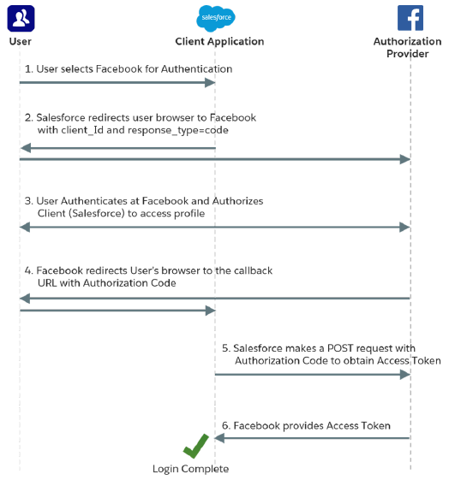
LDV Mitigation strategies
Strategy | Description
Indexes | Salesforce supports custom indexes to speed up queries, and you can create custom indexes by contacting Salesforce Customer Support.
Skinny tables | Salesforce can create skinny tables to contain frequently used fields and to avoid joins. Doing so keeps the skinny tables in sync with their source tables when the source tables are modified. If you want to use skinny tables, contact Salesforce Customer Support. When enabled, skinny tables are created and used automatically where appropriate. You can’t create, access, or modify skinny tables. For each object table, Salesforce maintains other, separate tables at the database level for standard and custom fields. This separation ordinarily requires a join when a query contains both kinds of fields. A skinny table contains both kinds of fields and does not include soft-deleted records.
Data archiving | Remove old data from Salesforce objects that are actively used to another internal or external archiving object or database
Managing Data Skew | Avoid records with a lot of child records (Account Skew, Ownership Skew, Lookup Skew). Use triggers instead of workflows, picklists instead of lookup and schedule automated updates at low load times to avoid record locking if needed.
OAuth & SSO Flow diagrams
Social Sign-On
(SP-Initiated SSO + Oauth)

Slide 37
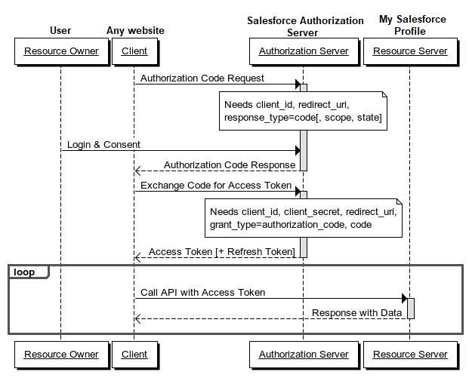
OAuth & SSO Flow diagrams
Web Server Flow
It should be used as soon as the client is a web server. It allows you to obtain a long-lived access token since it can be renewed with a refresh token (if the authorization server enables it).
Scenario:
A website wants to obtain information about your Google profile.
You are redirected by the client (the website) to the authorization server (Google).
If you authorize access, the authorization server sends an authorization code to the client (the website) in the callback response.
Then, this code is exchanged against an access token between the client and the authorization server.
The website is now able to use this access token to query the resource server (Google again) and retrieve your profile data.
You never see the access token, it will be stored by the website (in session for example). Google also sends other information with the access token, such as the token lifetime and eventually a refresh token.
This is the ideal scenario and the safer one because the access token is not passed on the client side (web browser in our example).

Slide 38
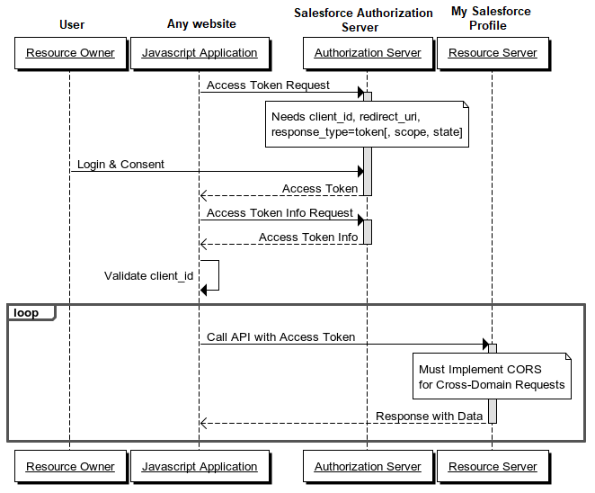
OAuth & SSO Flow diagrams
User Agent Flow
It is typically used when the client is running in a browser using a scripting language such as Javascript. This grant type does not allow the issuance of a refresh token.
Scenario:
The client (AngularJS) wants to obtain information about your Facebook profile.
You are redirected by the browser to the authorization server (Facebook).
If you authorize access, the authorization server redirects you to the website with the access token in the URI fragment (not sent to the web server). Example of callback: http://example.com/oauthcallback#access_token=MzJmNDc3M2VjMmQzN.
This access token can now be retrieved and used by the client (AngularJS) to query the resource server (Facebook). Example of query: https://graph.facebook.com/me?access_token=MzJmNDc3M2VjMmQzN.
This type of authorization should only be used if no other type of authorization is available. Indeed, it is the least secure because the access token is exposed (and therefore vulnerable) on the client side.

Slide 39
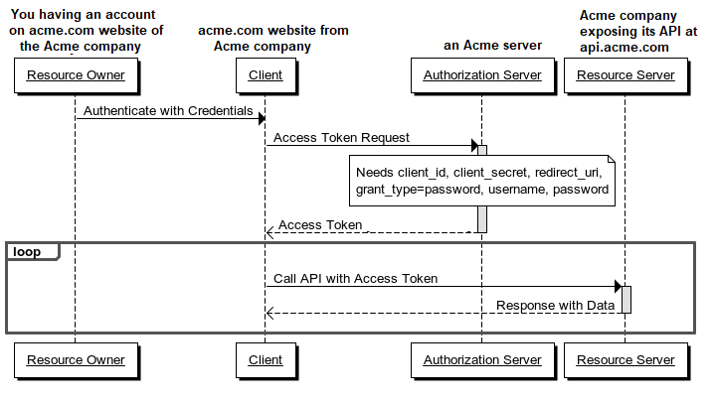
OAuth & SSO Flow diagrams
Username Password flow
With this type of authorization, the credentials (and thus the password) are sent to the client and then to the authorization server. It is therefore imperative that there is absolute trust between these two entities. It is mainly used when the client has been developed by the same authority as the authorization server. For example, we could imagine a website named example.com seeking access to protected resources of its own subdomain api.example.com. The user would not be surprised to type his login/password on the site example.com since his account was created on it. No refresh token is issued.
Scenario:
Acme company, doing things well, thought to make available a RESTful API to third-party applications.
This company thinks it would be convenient to use its own API to avoid reinventing the wheel.
Company needs an access token to call the methods of its own API.
For this, company asks you to enter your login credentials via a standard HTML form as you normally would.
The server-side application (website acme.com) will exchange your credentials against an access token from the authorization server (if your credentials are valid, of course).
This application can now use the access token to query its own resource server (api.acme.com).
Example: Salesforce App

Slide 40
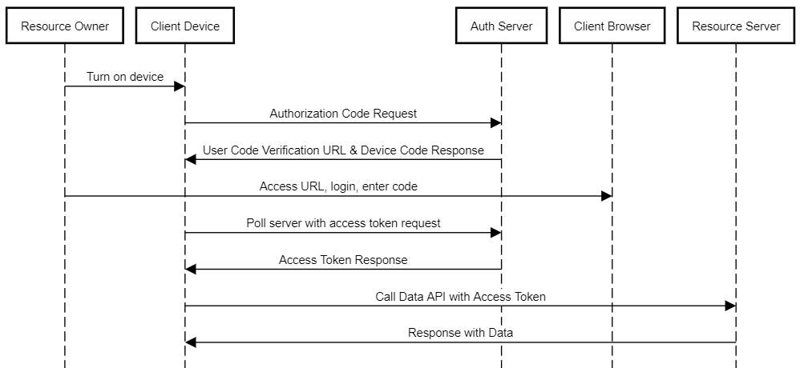
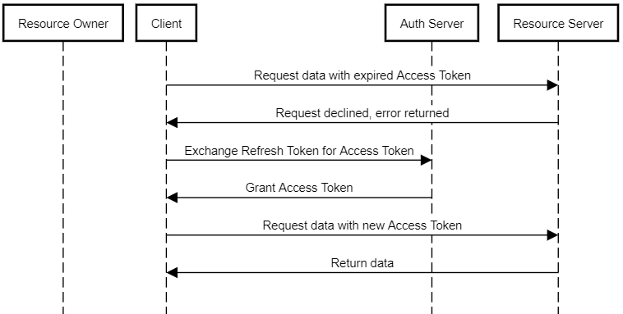
OAuth & SSO Flow diagrams
Device authentication flow
The OAuth 2.0 device authentication flow is typically used by applications on devices with limited input or display capabilities, such as TVs, appliances, or command-line applications. Users can connect these client applications to Salesforce by accessing a browser on a separate device that has more developed input capabilities, such as a desktop computer or smartphone.
Refresh token flow
The OAuth 2.0 refresh token flow is for renewing tokens issued by the web server or user-agent flows.

Slide 41
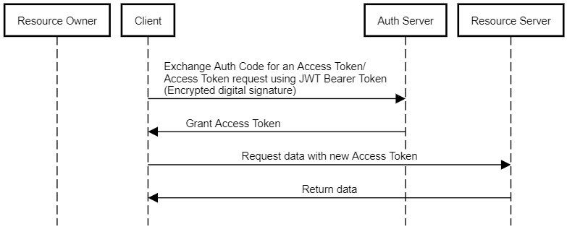
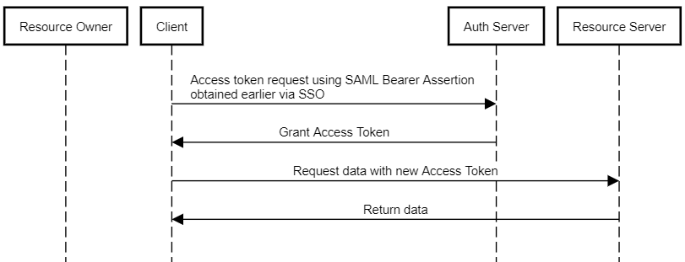
OAuth & SSO Flow diagrams
JWT Bearer token flow
JSON Web Token (JWT) is a JSON-based security token encoding that enables identity and security information to be shared across security domains.
The OAuth 2.0 JWT bearer token flow defines how a JWT can be used to request an OAuth access token from Salesforce when a client wants to use a previous authorization. Authentication of the authorized app is provided by a digital signature applied to the JWT.
SAML Bearer Assertion flow
A SAML assertion is an XML security token issued by an identity provider and consumed by a service provider. The service provider relies on its content to identify the assertion’s subject for security-related purposes.
The OAuth 2.0 SAML bearer assertion flow defines how a SAML assertion can be used to request an OAuth access token when a client wants to use a previous authorization. Authentication of the authorized app is provided by the digital signature applied to the SAML assertion.

Slide 42
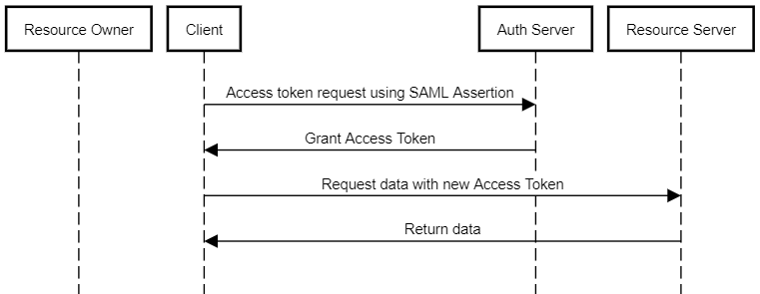
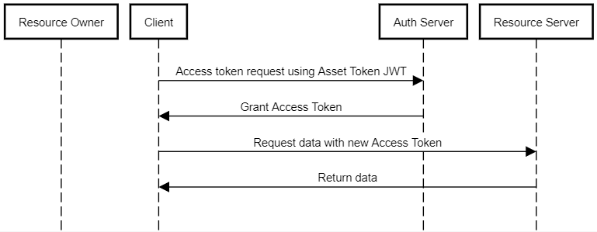
OAuth & SSO Flow diagrams
SAML Assertion flow
The SAML assertion flow is an alternative for orgs that are currently using SAML to access Salesforce and want to access the web services API the same way. You can use the SAML assertion flow only inside a single org. You don’t have to create a connected app to use this assertion flow. Clients can use this assertion flow to federate with the API using a SAML assertion, the same way they federate with Salesforce for web single sign-on.
Example: SSO with a company credentials(AD) using Salesforce App which then connects to Salesforce
Asset Token Flow
The OAuth 2.0 asset token flow is used by client applications to request an asset token from Salesforce for connected devices. In this flow, an OAuth access token and an actor token are exchanged for an asset token. This flow combines asset token issuance and asset registration, for efficient token exchange and automatic linking of devices to Service Cloud Asset data.
During asset token flow, Salesforce attempts to link the asset token to an existing Asset or to create an Asset.
If the asset claim contains an ID claim, attempt to link to an existing Asset with a matching ID.
Otherwise, if the asset claim contains a SerialNumber claim, attempt to link to an existing Asset with a matching serial number.
Otherwise, if the asset claim contains a Name claim, create (register) an Asset.
Otherwise, don’t link to or create an asset. You can separately link an asset later, via the API.

Slide 43
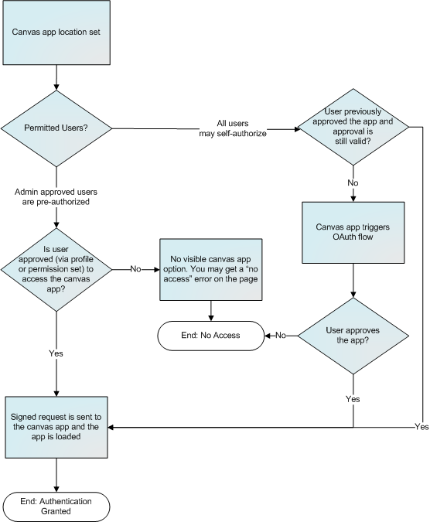
OAuth & SSO Flow diagrams
Canvas App User Flow - Signed Request
The default method of authentication for canvas apps. The signed request authorization flow varies depending on whether you configure the canvas app so that the administrator gives users access to the canvas app or if users can self-authorize. The signed request containing the consumer key, access token, and other contextual information is provided to the canvas app if the administrator has allowed access to the canvas app for the user or if the user has approved the canvas app via the approve/deny OAuth flow.

Slide 44
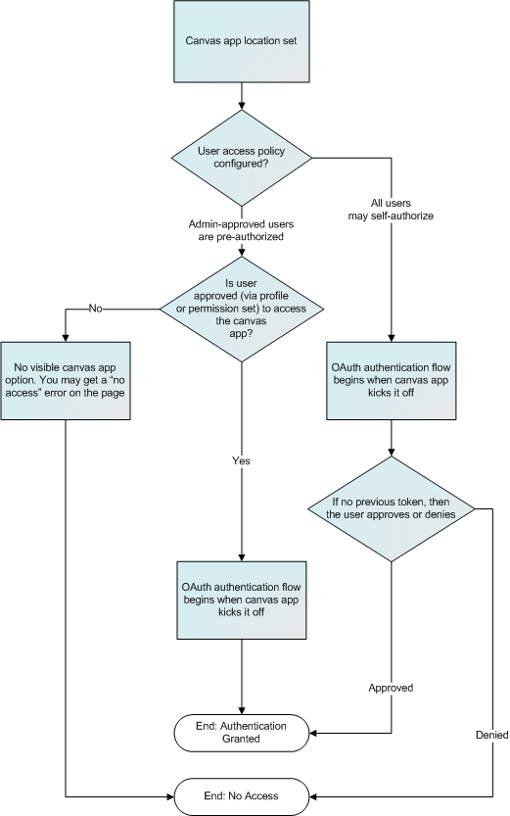
OAuth & SSO Flow diagrams
Canvas App User Flow - Oauth
Canvas apps can use the OAuth 2.0 protocol to authenticate and acquire access tokens.
If your canvas app uses OAuth authentication, the user experience varies depending on where the canvas app is located in the user interface and how the user access is set. This diagram shows the user flow for a canvas app that uses OAuth authentication.

Slide 45
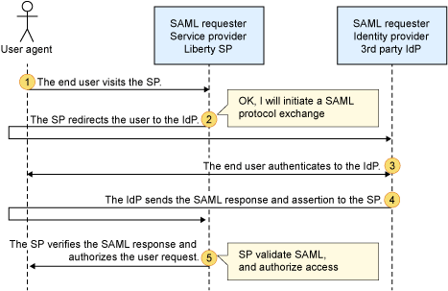
OAuth & SSO Flow diagrams
SAML Single Sign-On for Canvas Apps
With this feature you can create a canvas app that begins a standard SAML authentication flow when opened by a user. After this process completes, the user is authenticated into your Web application.
For canvas apps that use signed request authentication, two methods that are included in the Canvas SDK enable your canvas app to call into Salesforce to receive a new signed request directly or enable Salesforce to repost the signed request to your Web application endpoint. This results in a complete end-to-end authentication flow.
refreshSignedRequest Method
Returns a new signed request via a callback. After the SAML SSO process is completed, your app can call this method and receive a new signed request. This method is intended for developers who need to retrieve the signed request by using a more client-side JavaScript approach. (The Canvas SDK sends the signed request to your app.)
repost Method
Requests the parent window to initiate a POST to your canvas app and reloads the app page with a refreshed signed request. After the SAML SSO process is completed, your app can call this method and a new signed request is sent to your app via a POST. This method is for developers who want to retrieve the signed request using a more server-side approach. (Salesforce POSTs the signed request to your server.)
SP Initiated SAML SSO

Slide 46
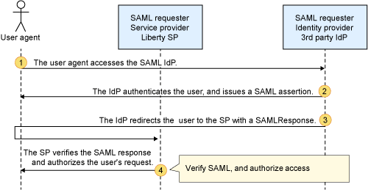
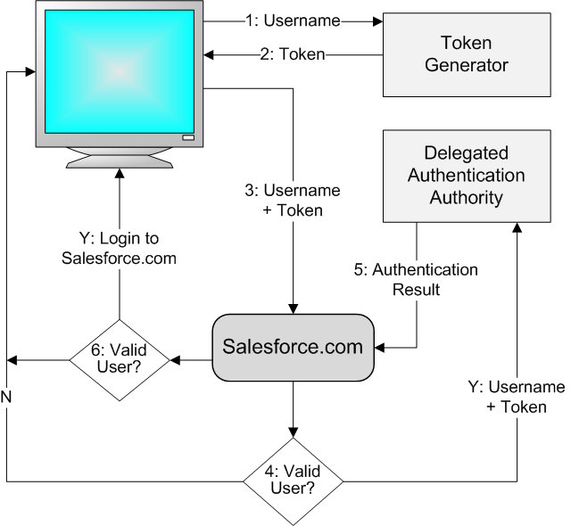
OAuth & SSO Flow diagrams
IdP Initiated SAML SSO
Delegated authentication flow

